Slide 1
Optimizing Query Performance in Cloud Data Warehousing
A Comparative Analysis of Microsoft Azure Synapse, Amazon Redshift, and Oracle Autonomous Data Warehouse
By Cruz Bello

Slide 2
Research Context & Problem
Context
• Cloud data warehouses now essential for modern analytics
• SMEs face challenges selecting optimal platforms
• Performance varies significantly across platforms
Research Gap
• Conflicting benchmark results in literature
• No neutral comparison under identical conditions
• Limited guidance for SME adoption decisions
Research Objectives
1. Benchmark three leading platforms using TPC-DS and TPC-H at 10GB scale
2. Evaluate platform-specific optimization strategies
3. Develop evidence-based decision framework for SMEs

Slide 3
Research Context & Problem
Context
• Cloud data warehouses now essential for modern analytics
• SMEs face challenges selecting optimal platforms
• Performance varies significantly across platforms
Research Gap
• Conflicting benchmark results in literature
• No neutral comparison under identical conditions
• Limited guidance for SME adoption decisions
Research Objectives
1. Benchmark three leading platforms using TPC-DS and TPC-H at 10GB scale
2. Evaluate platform-specific optimization strategies
3. Develop evidence-based decision framework for SMEs

Slide 4
Research Methodology
Seven-Phase Experimental Pipeline
1
Data Prep
2
Provision
3
Ingest Data
4
Baseline
5
Optimize
6
Aggregate
7
Evaluate
Benchmarks
• TPC-DS: 99 queries, 24 tables
• TPC-H: 22 queries, 8 tables
• Scale Factor: 10GB (SME-representative)
Statistical Analysis
• Kruskal-Wallis H-test (α=0.05) - Tests whether there are statistically significant differences in median query latency across the three platforms and complexity level
• Dunn's post-hoc comparisons - After Kruskal-Wallis detects differences, Dunn's test identifies which specific pairs of platforms differ from each other.
• Cliff's Delta effect sizes - Quantifies how large the performance difference is between platforms, not just whether it's statistically significant.
• n=20 iterations per query

Slide 5
Platform Configurations
Strategy: Minimum production-tier matching to reflect real-world SME adoption constraints
Platform | Configuration | Cost/Hour | Justification
Azure Synapse | DW200c | $1.60 | Vendor minimum Gen2 production tier
Amazon Redshift | 2 × RA3.large | $1.08 | Minimum RA3 cluster (32GB per node)
Oracle ADW | 4 ECPUs | $1.04 | Minimum ADW ECPU configuration

Slide 6
Baseline Performance Results
Baseline Performance Results
TPC-DS Performance
Baseline Performance Results
TPC-H Performance
Platform | p50 (s) | p99 (s) | QPH
Oracle ADW | 0.014 | 0.225 | 148,072
Redshift | 0.019 | 0.229 | 191,168
Synapse | 4.080 | 27.342 | 2,414
Platform | p50 (s) | p99 (s) | QPH
Oracle ADW | 0.016 | 9.221 | 21,189
Redshift | 0.018 | 3.271 | 71,338
Synapse | 5.389 | 22.495 | 2,110
Oracle ADW
Lowest median latency, exceptional consistency
Redshift
Competitive performance, superior TPC-H throughput
Synapse
DW200c inadequate for production workloads

Slide 7
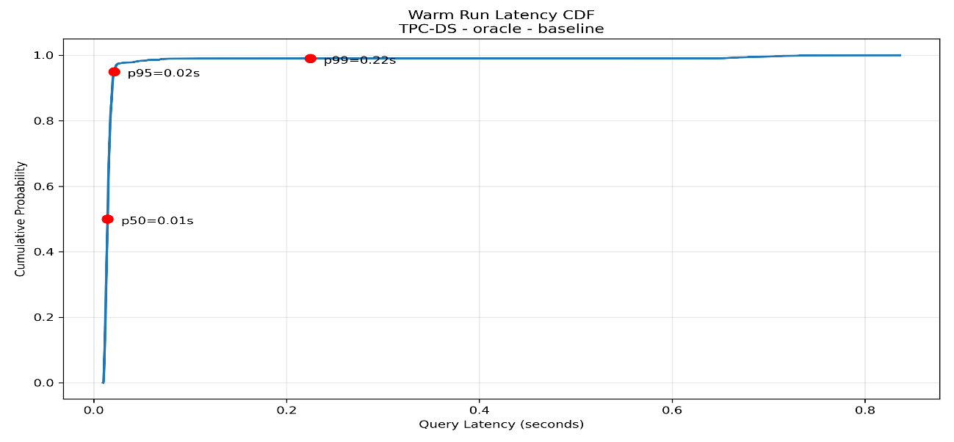
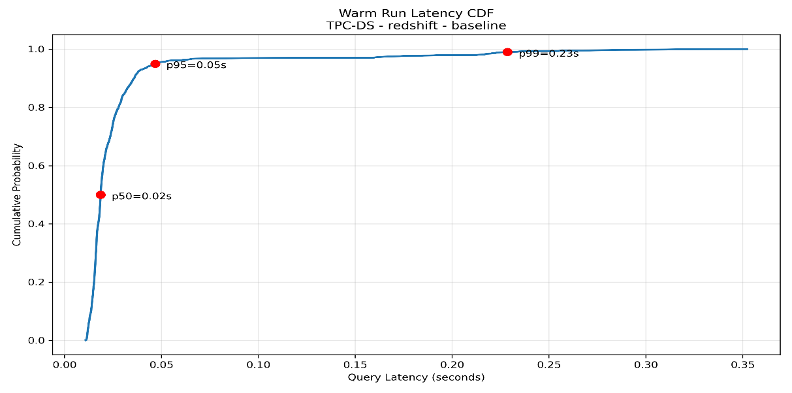
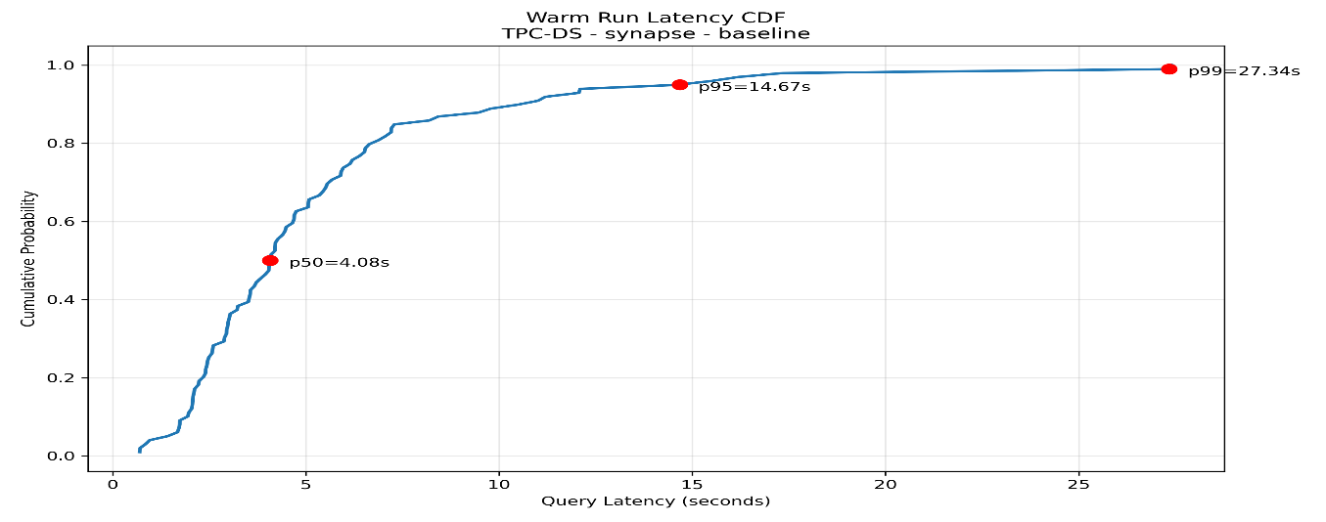
Baseline Performance latency Results

Slide 8
Optimization Intervention Results
1. Compression Tuning
-0.97%
Oracle ADW (TPC-DS)
-3.38%
Redshift (TPC-DS)
-49.23%
Synapse (TPC-H)
2. Distribution Key and Partition Optimization
-3.98%
Redshift (TPC-DS)
Top: query 20 (-30.90%)
+123.01%
Synapse (TPC-DS)
79 queries degraded
+1.32%
Oracle Partitioning (TPC-DS)
Mixed results (query 34 -98.12%,query10 +37.00%)
3. Materialized Views
-0.61%
Oracle (TPC-DS)
-9.60%
Redshift (TPC-H)
+1.16%
Synapse (TPC-DS)
Key Finding: Optimization effectiveness highly variable and platform-dependent. Resource constraints (Synapse DW200c) can negate traditional optimization strategies.

Slide 9
Concurrency Scaling Performance
TPC-DS Throughput Scaling (1 → 20 concurrent sessions)
12.2×
Oracle ADW
148K → 1.8M QPH
Latency: 0.014s → 0.020s
1.8×
Redshift
191K → 354K QPH
Latency: 0.019s → 0.201s
1.4×
Synapse
2.1K → 3.0K QPH
Latency: 5.6s → 63.6s
Oracle ADW
Superlinear throughput scaling
Minimal latency degradation (1.4×)
Autonomous resource management
Excellent p99 stability (0.108s → 0.153s)
Redshift & Synapse
Redshift: p99 explosion (0.228s → 1.548s)
Workload queue limitations evident
Synapse: 11.3× median latency increase
Resource constraints prevent scaling
Implication: Autonomous optimization (Oracle) provides superior multi-user performance. Manual tuning required for Redshift. Synapse requires higher tier provisioning.

Slide 10
Statistical Analysis
Statistical Analysis with Optimizations (TPC-DS):
Kruskal-Wallis H-test: Would still reject H₀ (p ≈ 0.000). The gap between Synapse and others remains enormous.
Dunn's Post-Hoc Comparisons:
  Synapse vs. Oracle ADW: Extremely significant (p ≈ 0.000)
  Synapse vs. Redshift: Extremely significant (p ≈ 0.000)
  Oracle ADW vs. Redshift: Now more competitive. Oracle has better p50 and p99, but Redshift has higher QPH.
Cliff's Delta Effect Sizes:
  Synapse vs. Oracle ADW: δ ≈ +1.0 (Large)
  Synapse vs. Redshift: δ ≈ +1.0 (Large)
  Oracle ADW vs. Redshift: δ ≈ -0.15 (Negligible/Small) - Very similar performance profiles

Slide 11
Key Research Findings
1. Performance Disparities
Oracle ADW demonstrated lowest median latency (0.014s TPC-DS) and exceptional consistency. 61× throughput advantage over Synapse's entry-level configuration.
2. Optimization Effectiveness Varies
Compression: 3-49% improvements. Distribution keys: -30% to +123% variance. Materialized views: 0.6-68% per-query effects. Results highly dependent on platform maturity and resource provisioning.
3. Resource Provisioning Critical
Azure Synapse DW200c proved inadequate for production workloads. Traditional optimization strategies can degrade performance under resource constraints.
4. Autonomous vs Manual Tuning
Oracle's autonomous optimization provided consistent performance without manual intervention. Redshift and Synapse require DBA expertise for optimization.
5. Workload Sensitivity
Platform performance varies by query complexity. Oracle excels at simple queries (caching), Redshift competitive on moderate joins, all platforms struggle with complex nested subqueries at 10GB scale.

Slide 12
Platform-Specific Recommendations
Oracle ADW
Best For:
Operational simplicity priority
Multi-user analytics
Limited DBA expertise
Considerations:
Higher cost ($1.04/hr base)
Provision 8+ ECPUs for TB-scale
Excellent consistency
Amazon Redshift
Best For:
Technical teams
Cost-conscious deployments
OLAP-heavy workloads
Considerations:
Requires DBA tuning
Distribution key critical
Best cost efficiency
Azure Synapse
Best For:
Azure ecosystem users
Power BI integration
Adequate provisioning (≥DW500c)
Considerations:
DW200c inadequate
Requires tier planning
Schema design critical
Decision Framework
Operational simplicity priority: Oracle ADW (autonomous optimization, compression yields modest improvements; check heavy outliers)
Cost optimization with technical expertise: Amazon Redshift (Distribution key produced the largest overall improvement in your runs, mean −3.98%)
Azure ecosystem lock-in: Synapse with ≥DW500c provisioning (Tuning had mixed effects)
High concurrency requirements: Oracle ADW (12.2× scaling)

Slide 13
Conclusions & Future Directions
Research Contributions
✓ Neutral tri-platform comparison under controlled conditions
✓ Explicit cold/warm run separation methodology
✓ Marginal attribution of optimization effects
✓ Telemetry-driven root cause analysis
✓ Evidence-based SME decision framework
Key Takeaways
Platform Choice: No universal winner; depends on workload and expertise
Provisioning: Entry-level tiers may prove false economies
Optimization: Highly context-dependent; test before deploying
Limitations
10GB scale factor (SME-focused but limits TB/PB generalizability)
Single region deployment (US-East)
Temporal validity (October 2025 snapshot)
Resource imbalance across configurations
Future Research Directions
Larger scale factors (SF100-SF1000) for enterprise validation
Multi-region performance and cost analysis
Real-world workload traces beyond synthetic benchmarks
Cost-per-query economic modeling
Synapse Spark pool evaluation for complex analytics
(Click the arrow when in Slide Show mode)
Notes:
In Slide Show mode, click the arrow to enter the PowerPoint Getting Started Center.

